Slide 1
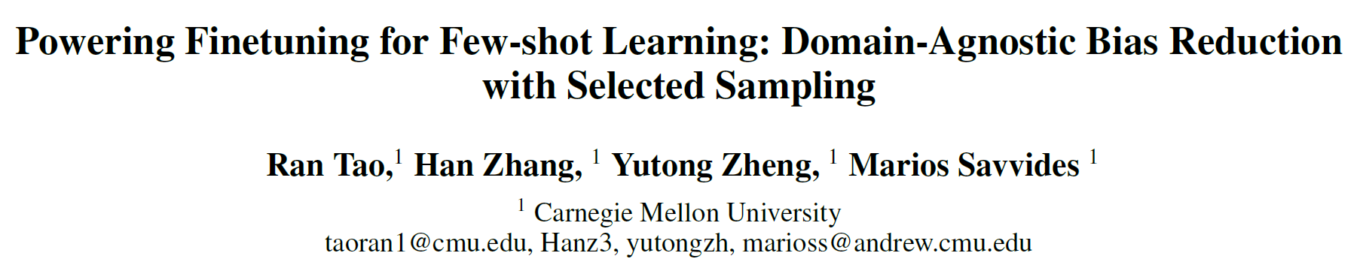
Published in AAAI 2022
Jeonbuk National University, Korea
Multimedia Lab Under Prof. Park and Prof. Yoon
Mingle Xu
2022

Slide 2
Task formulation
Task dataset:
Few shot: several labeled images
Algorithms
Transfer learning
Meta-learning

Slide 3
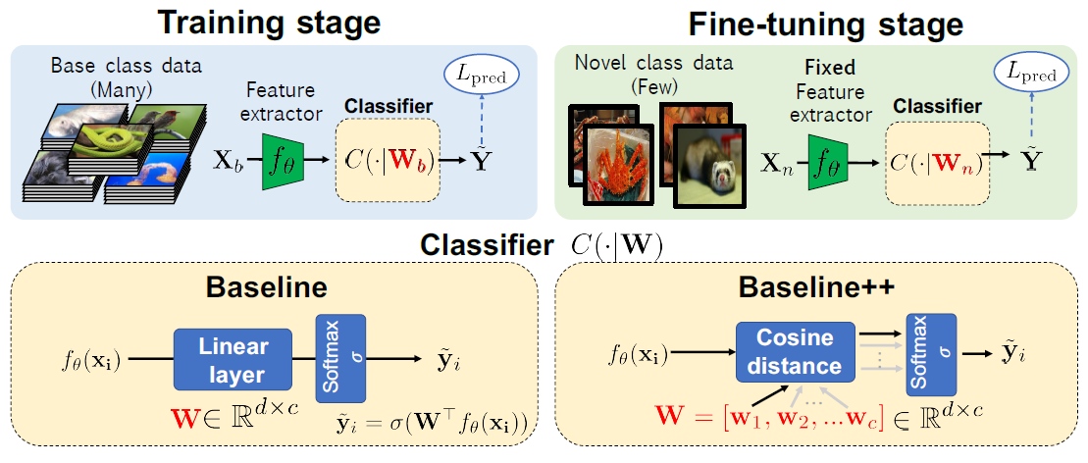
Fine-tuning
Pretrain: large annotated source dataset
Fine-tuning: few-shot target dataset
Testing: target dataset
Base classes
Novel classes
Chen, Wei-Yu, et al. "A Closer Look at Few-shot Classification." International Conference on Learning Representations. 2018.

Slide 4
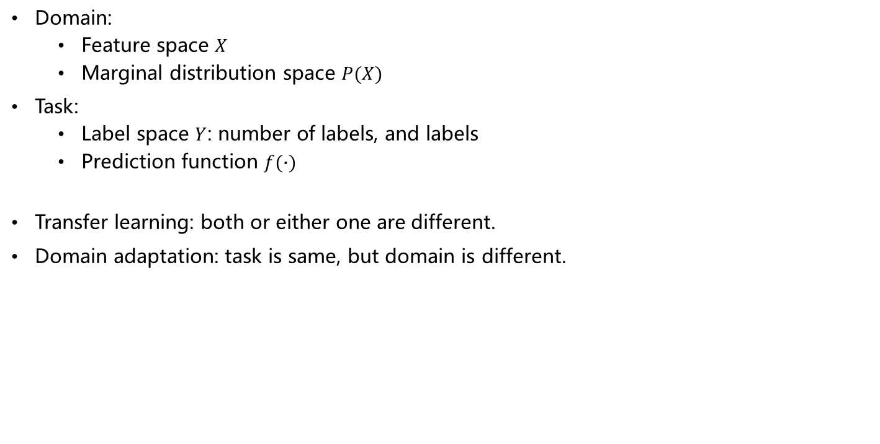
Domain:
Feature space $X$
Marginal distribution space $P(X)$
Task:
Label space $Y$: number of labels, and labels
Prediction function $f(∙)$
Transfer learning: both or either one are different.
Domain adaptation: task is same, but domain is different.
Pan, Sinno Jialin, and Qiang Yang. "A survey on transfer learning." IEEE Transactions on knowledge and data engineering 22.10 (2009): 1345-1359.

Slide 5
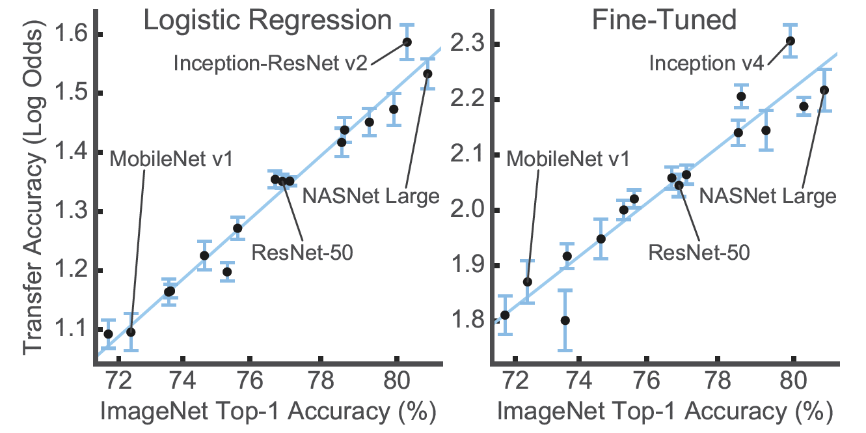
A summary on transfer learning
A model with higher accuracy in ImageNet tends to have good accuracy when fine-tuning
Kornblith, Simon, Jonathon Shlens, and Quoc V. Le. "Do better imagenet models transfer better?." Proceedings of the IEEE/CVF conference on computer vision and pattern recognition. 2019.

Slide 6
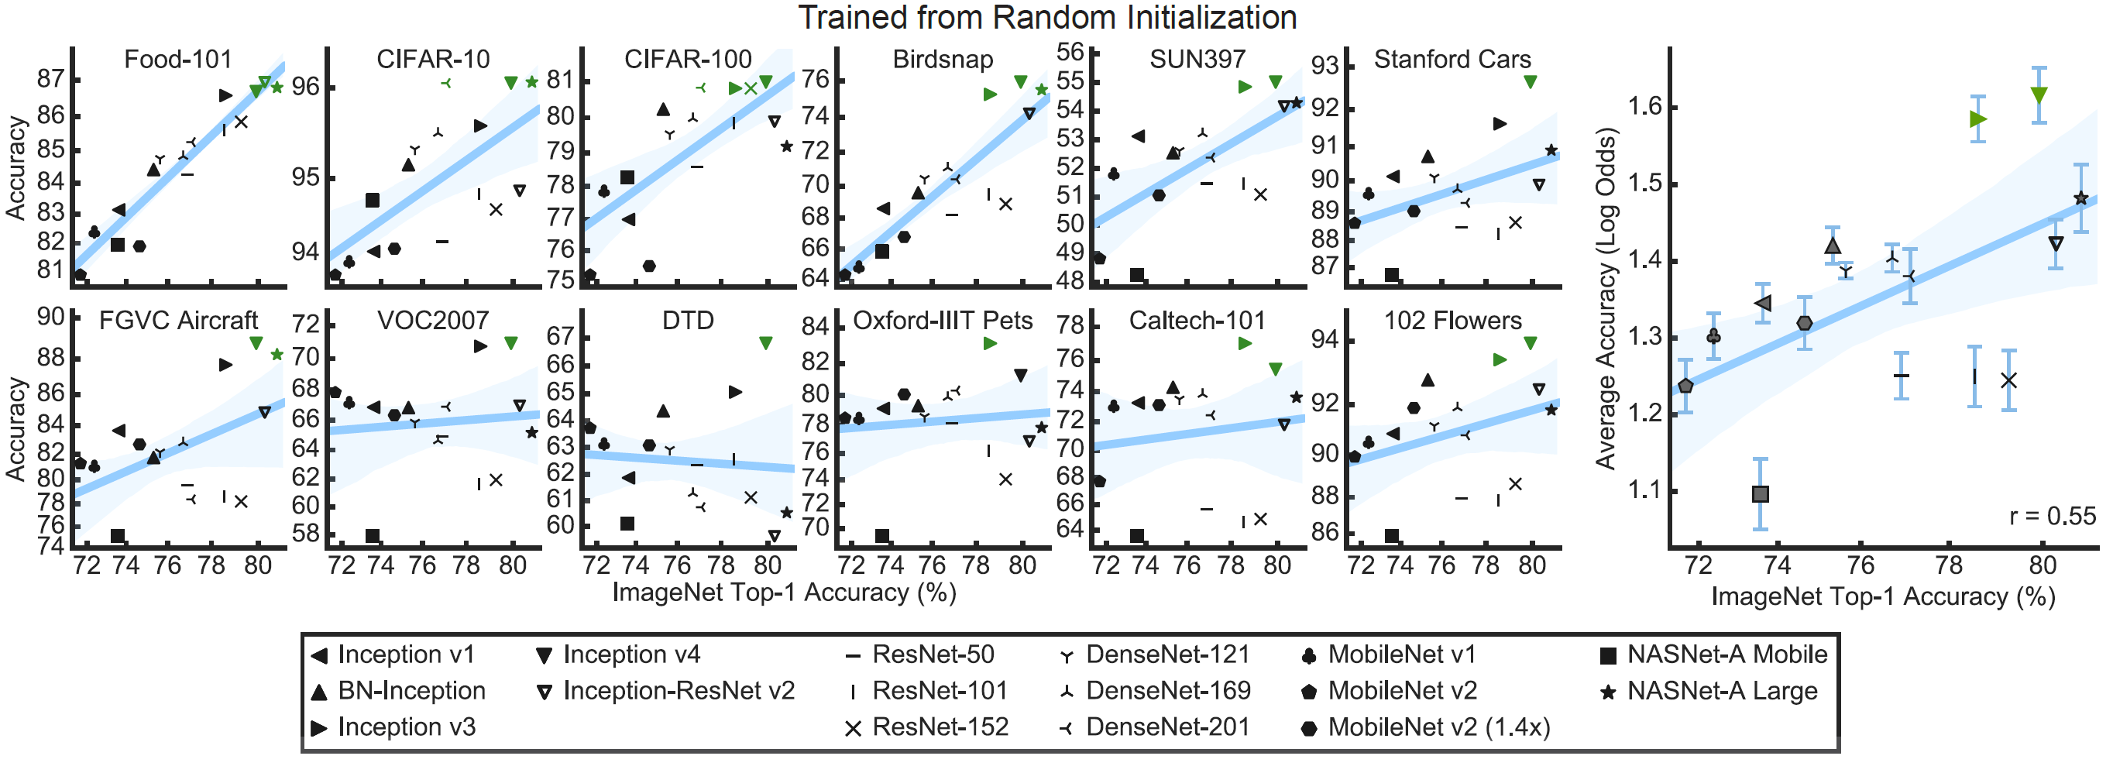
A summary on transfer learning
A model with higher accuracy in ImageNet tends to have good accuracy when fine-tuning
Weight or architecture?
Different domain
Different task
Kornblith, Simon, Jonathon Shlens, and Quoc V. Le. "Do better imagenet models transfer better?." Proceedings of the IEEE/CVF conference on computer vision and pattern recognition. 2019.

Slide 7
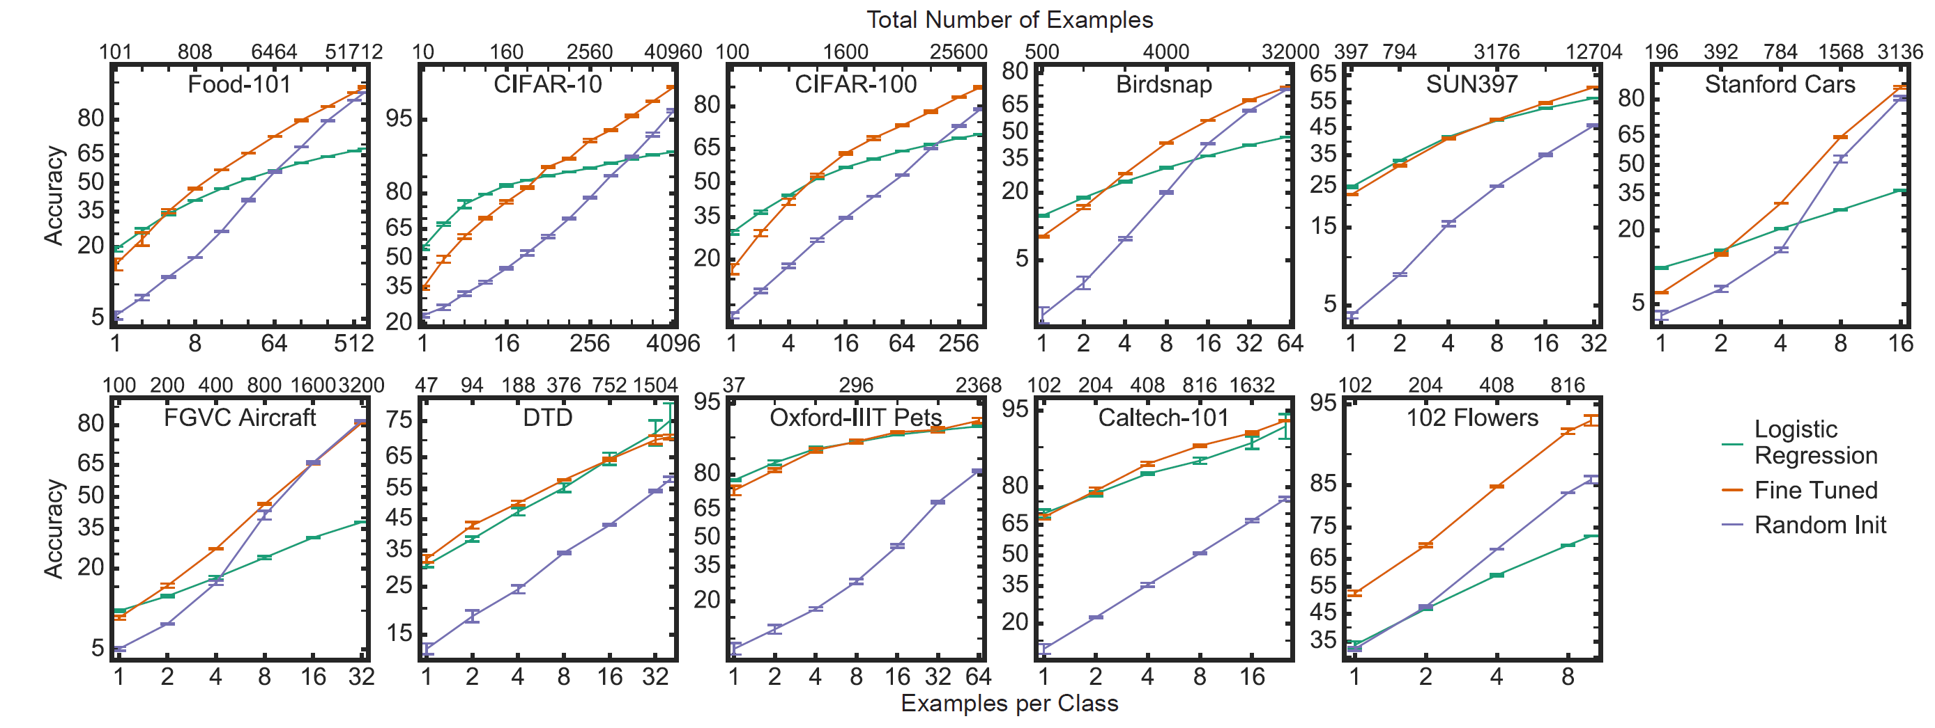
A summary on transfer learning
Accuracy benefits of ImageNet pretraining fade quickly with dataset size
Kornblith, Simon, Jonathon Shlens, and Quoc V. Le. "Do better imagenet models transfer better?." Proceedings of the IEEE/CVF conference on computer vision and pattern recognition. 2019.

Slide 8
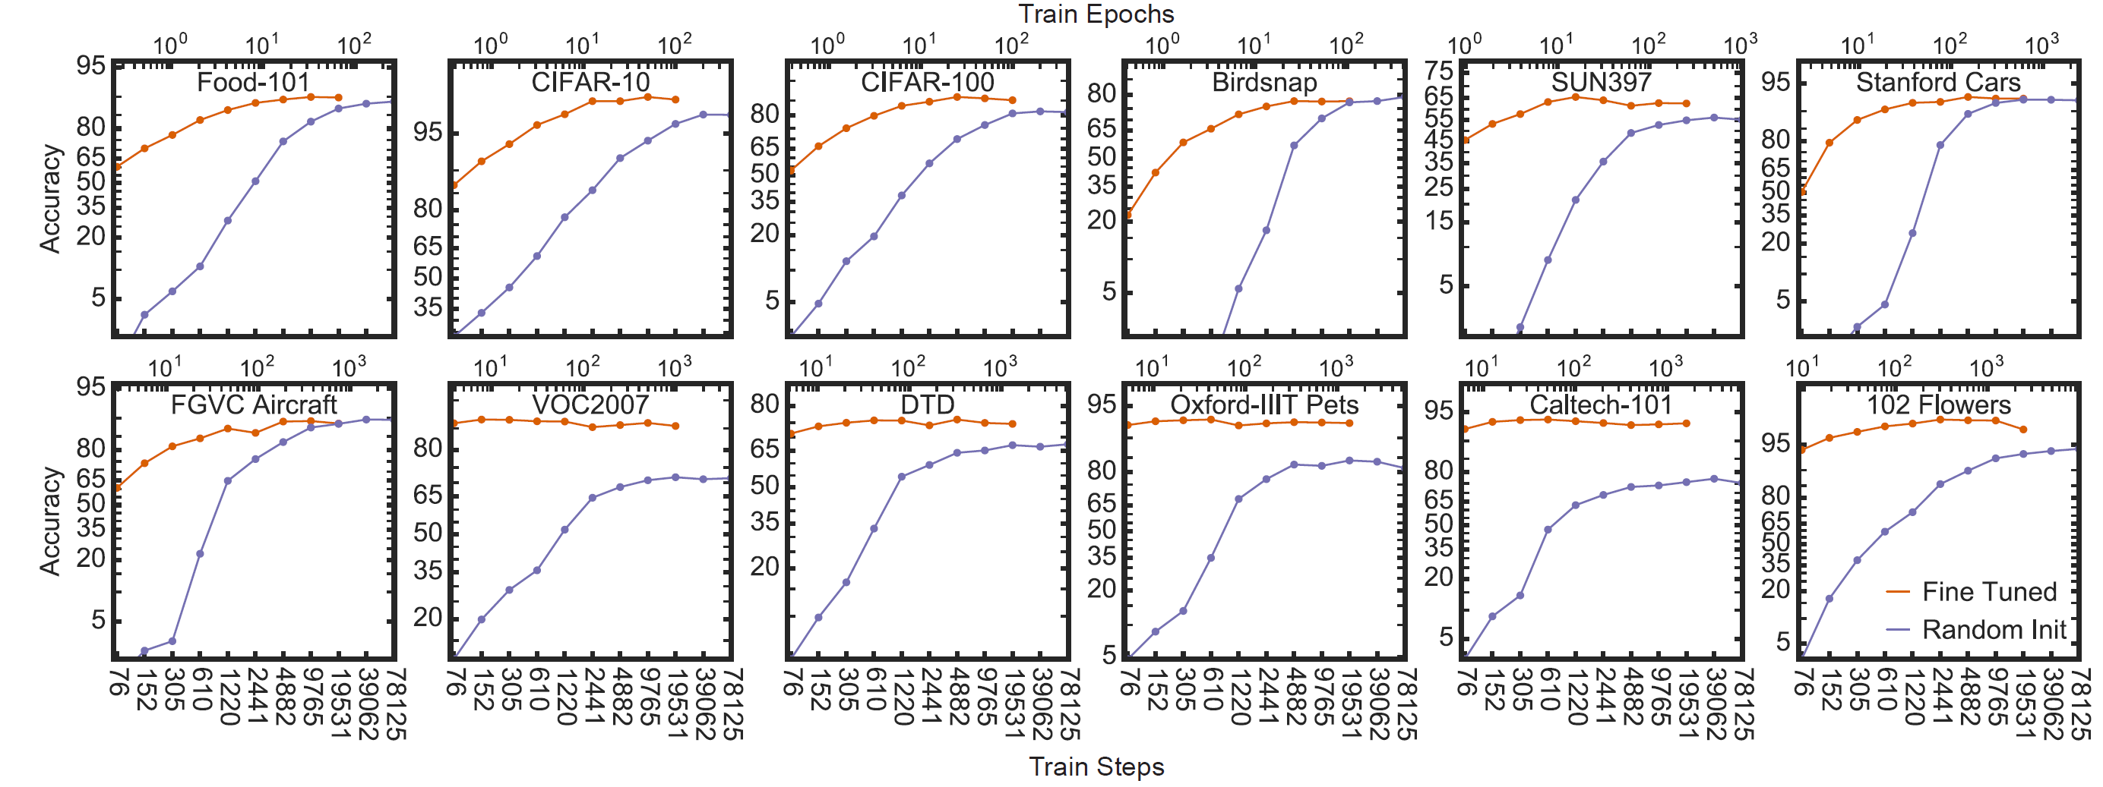
A summary on transfer learning
ImageNet pretraining accelerates convergence
Kornblith, Simon, Jonathon Shlens, and Quoc V. Le. "Do better imagenet models transfer better?." Proceedings of the IEEE/CVF conference on computer vision and pattern recognition. 2019.

Slide 9
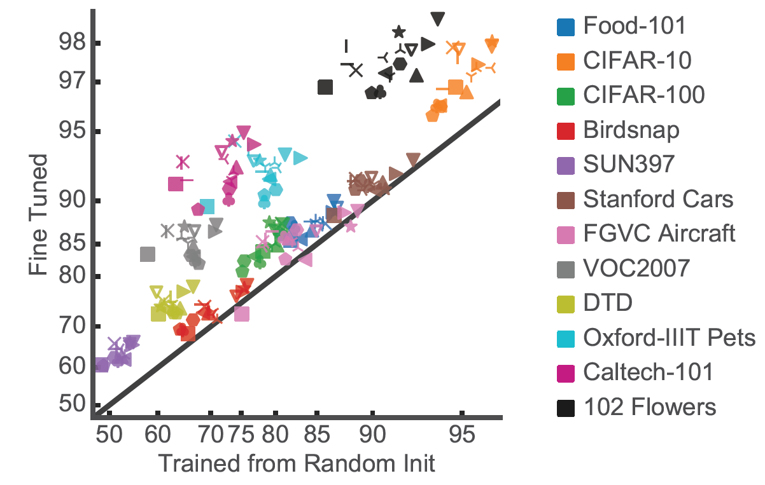
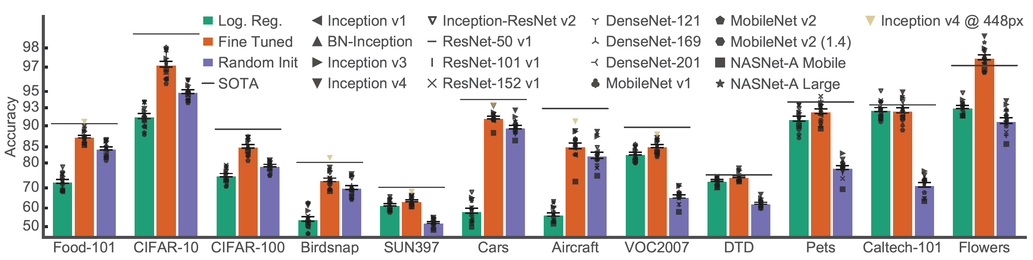
A summary on transfer learning
ImageNet pretraining does not necessarily improve accuracy on fine-grained tasks
Stanford Cars
FGVC Aircraft
Kornblith, Simon, Jonathon Shlens, and Quoc V. Le. "Do better imagenet models transfer better?." Proceedings of the IEEE/CVF conference on computer vision and pattern recognition. 2019.

Slide 10
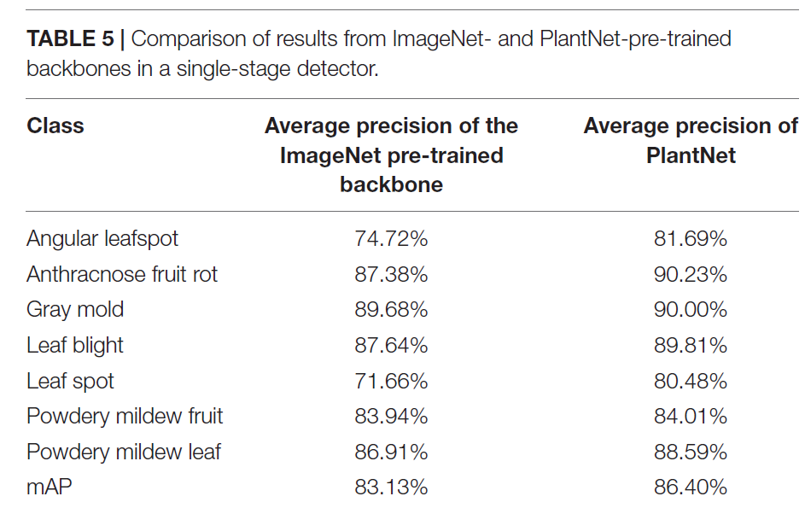
A summary on transfer learning
The difference between base classes and novel classes matters
Domain difference.
Kim, Byoungjun, et al. "Improved vision-based detection of strawberry diseases using a deep neural network." Frontiers in Plant Science 11 (2021): 559172.

Slide 11
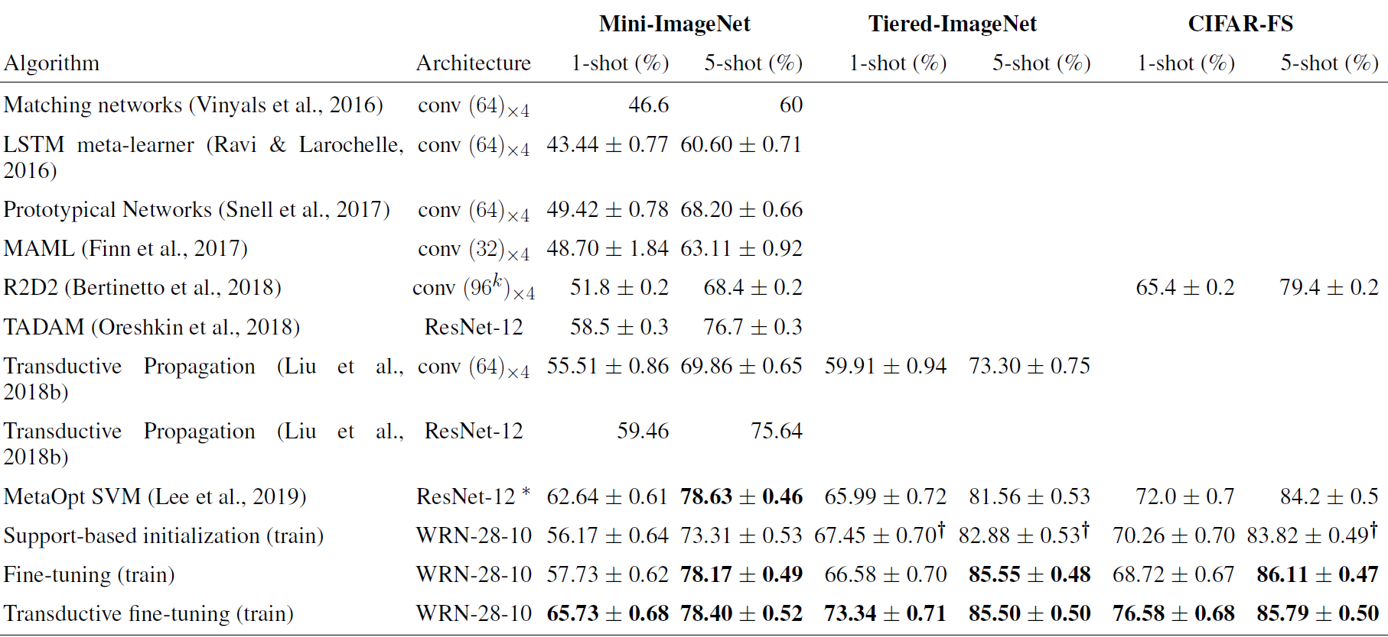
A summary on transfer learning
Unlabeled data in target domain is also useful
Dhillon, Guneet Singh, et al. "A Baseline for Few-Shot Image Classification." International Conference on Learning Representations. 2019.

Slide 12
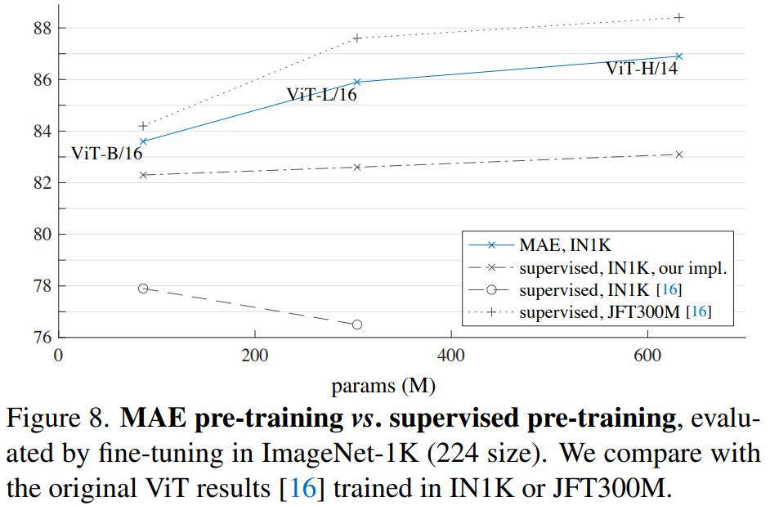
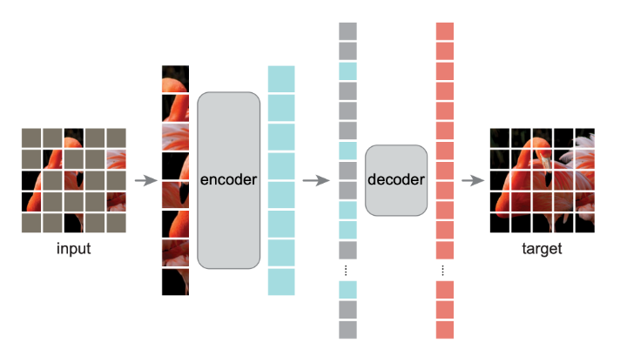
One new trend on transfer learning
Source dataset is annotated → not annotated
Self-supervised learning
Reconstruction
Why: task-independent feature space
He, Kaiming, et al. "Masked autoencoders are scalable vision learners." Proceedings of the IEEE/CVF Conference on Computer Vision and Pattern Recognition. 2022.
Wu, Zhirong, et al. "Unsupervised feature learning via non-parametric instance discrimination." Proceedings of the IEEE conference on computer vision and pattern recognition. 2018.

Slide 13
Strategies to use feature extractor in few-shot
Common choice of fine-tuning for few-shot:
Fix the feature extractor
Cosine similarity
Feature extractor:
Retrain the feature extractor
Fixed part or all feature extractor
How to create classifier
Linear function
Protocol
Cosine similarity
Chen, Wei-Yu, et al. "A Closer Look at Few-shot Classification." International Conference on Learning Representations. 2018.

Slide 14
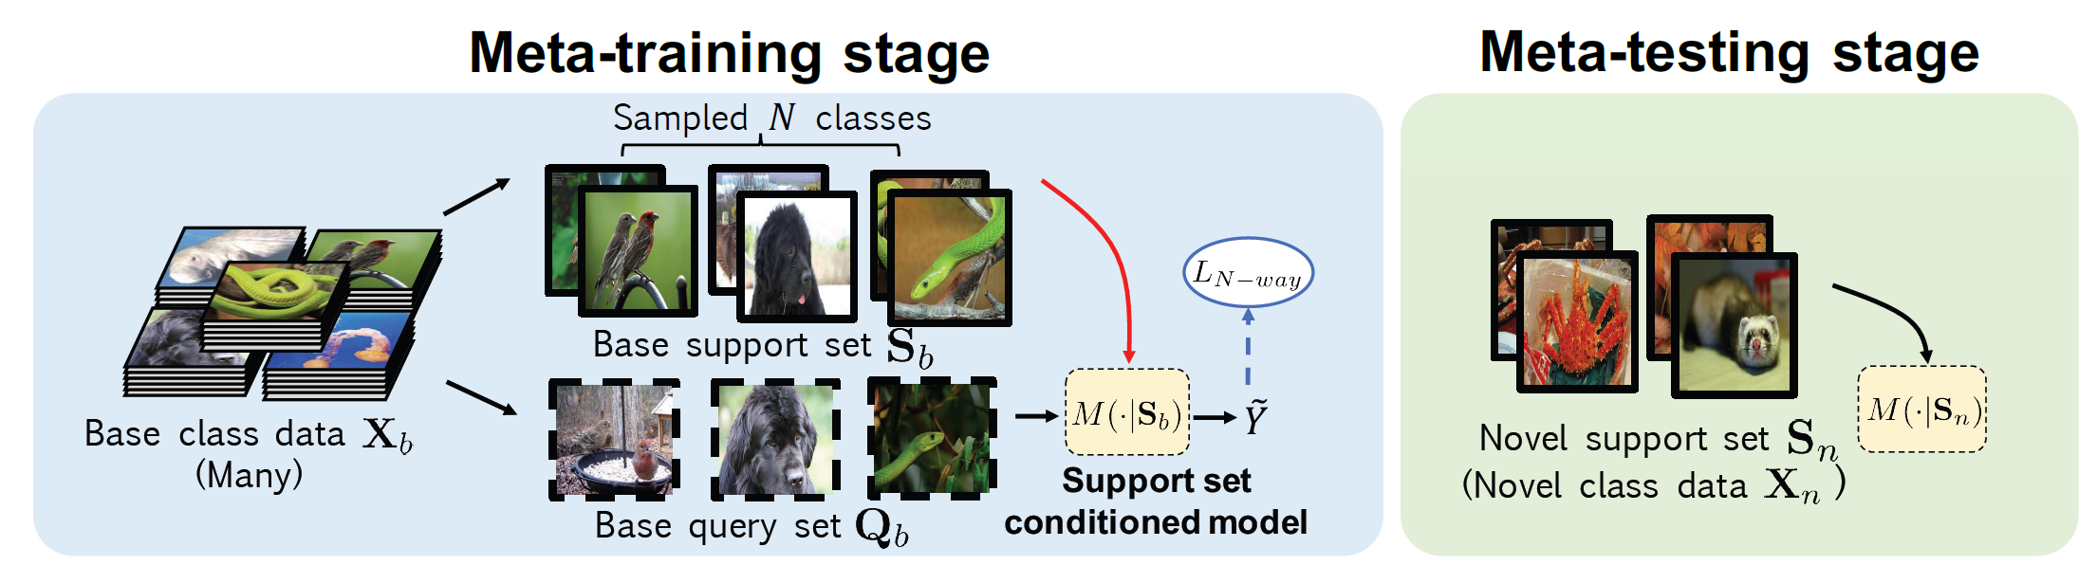
Meta-learning
Meta-training: N-way K-shot
Training dataset → support
Testing dataset → query
Metal-testing:
Base classes
Novel classes
Chen, Wei-Yu, et al. "A Closer Look at Few-shot Classification." International Conference on Learning Representations. 2018.

Slide 15
Comparison between fine-tuning and meta-learning
Fine-tuning in transfer learning:
Transfer knowledge (model weight)
Different label space
May different prediction function
Only two tasks
Meta-learning:
Learn how to learn
Hyper-parameter
framework
Number is same, but different labels
Same prediction function
Many tasks

Slide 16
Meta-learning detail
Meta-training:
Task 1: support (training dataset) and query (testing dataset)
Task 2
…
Meta-testing
Task 1
Task 2
…

Slide 17
Published in AAAI 2022
Jeonbuk National University, Korea
Multimedia Lab Under Prof. Park and Prof. Yoon
Mingle Xu
2022

Slide 18
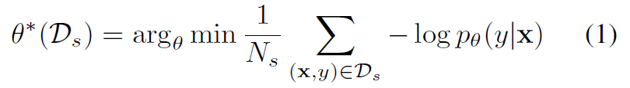
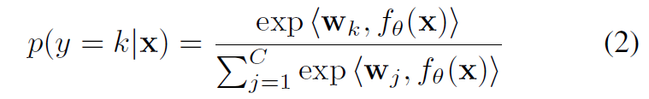
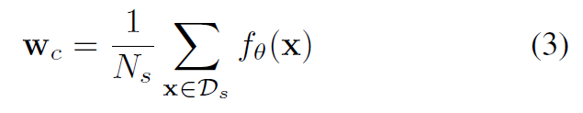
Basic setting:
Pretraining in meal-training dataset
Cosine similarity
Mean prototype (do not fix the feature extractor, fine-tuning)
Few-shot

Slide 19
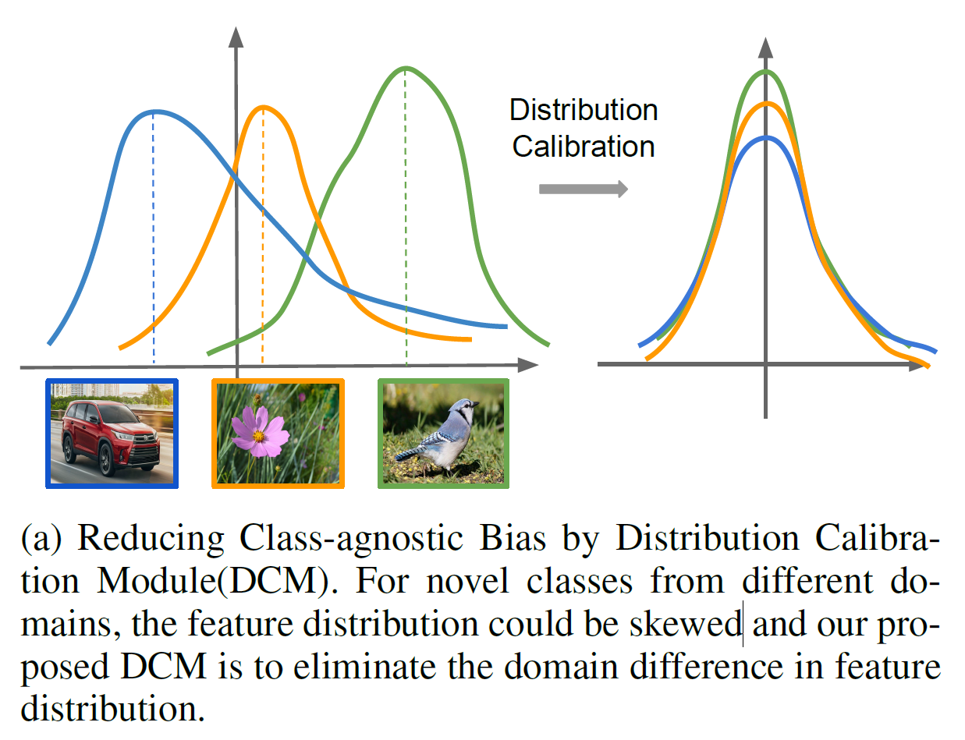
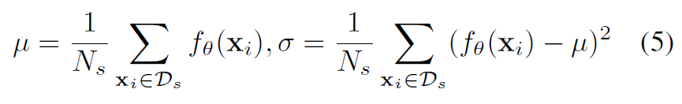
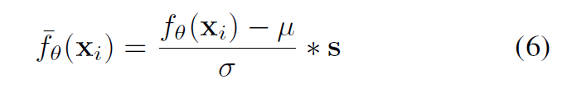
Challenge 1
Class-agnostic bias: difference of feature distribution between base classes and novel classes
Distribution Calibration Module
But I query why no bias.

Slide 20
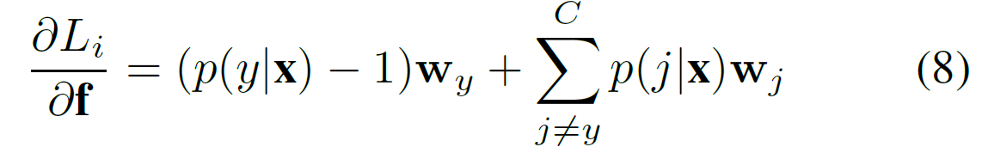
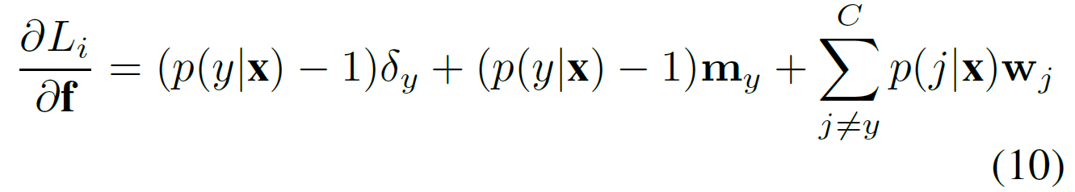
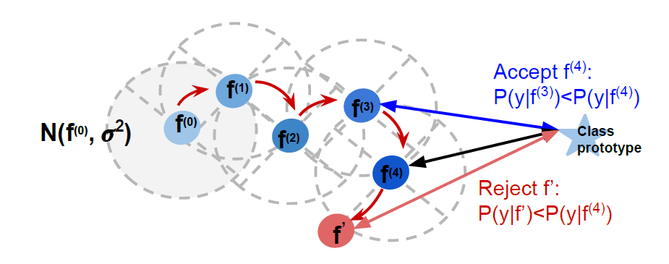
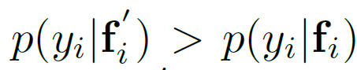
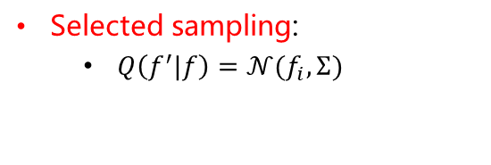
Challenge 2
Class-specific bias: only few-sample, the distribution is biased for each target class.
Selected sampling:
$Q\left(f^{′}|f\right)=𝒩(f_{i},Σ)$
But I query the efficiency.

Slide 21
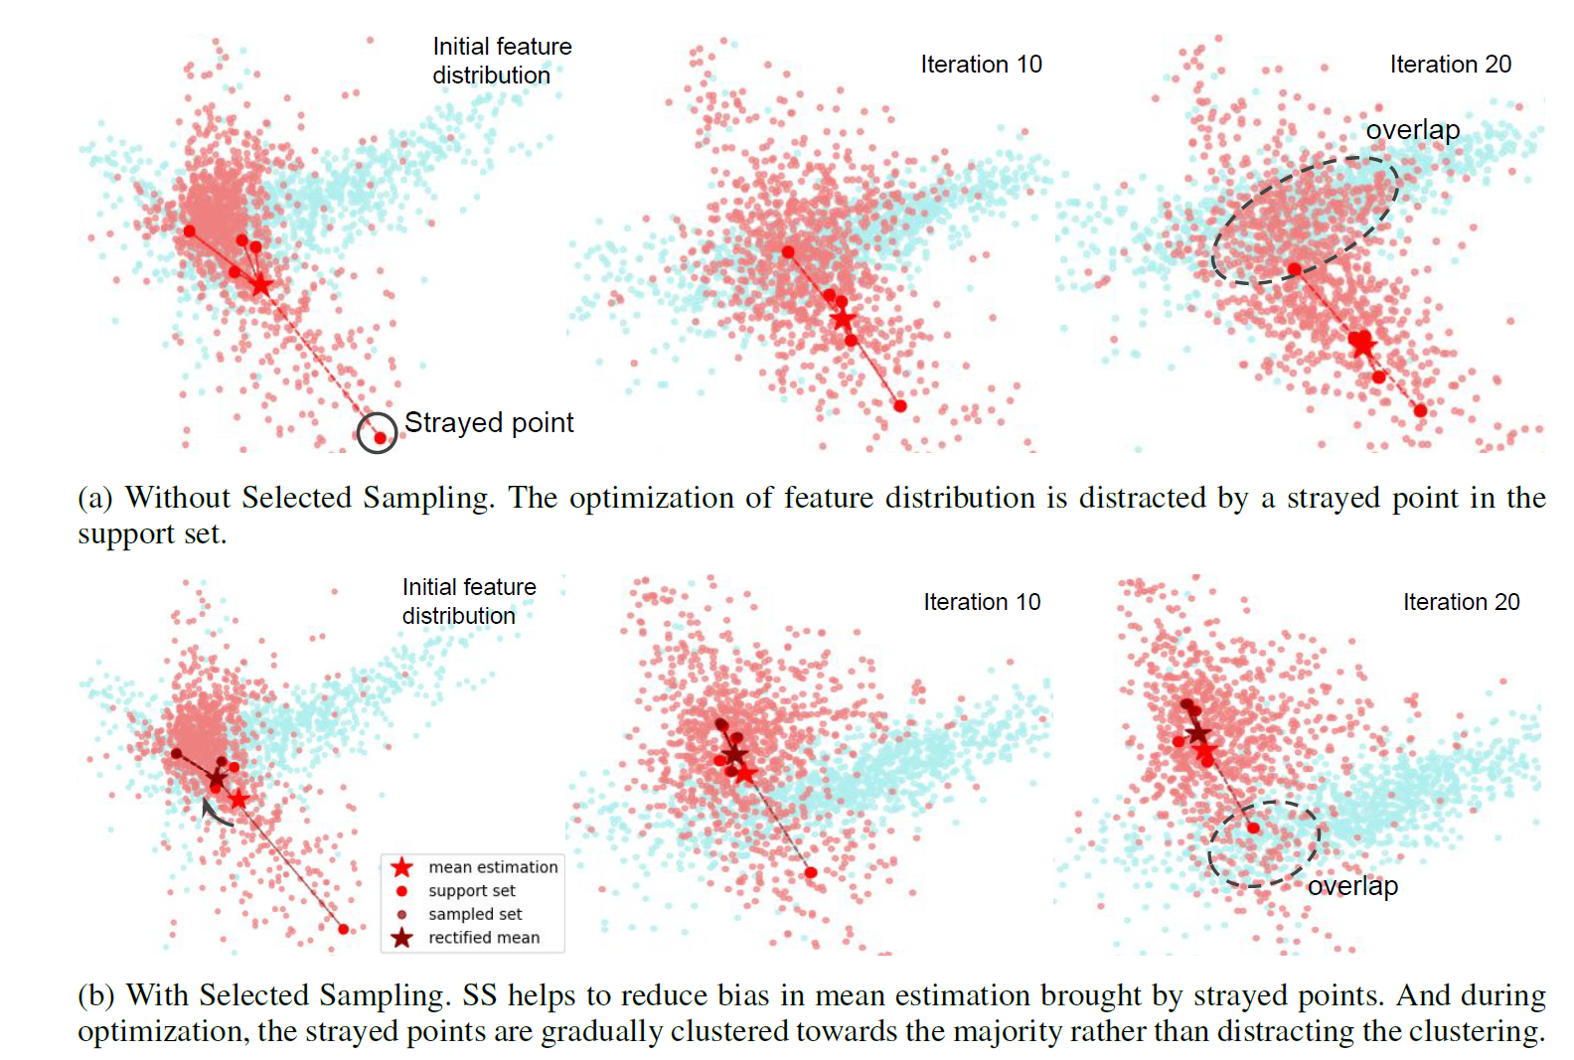

Slide 22
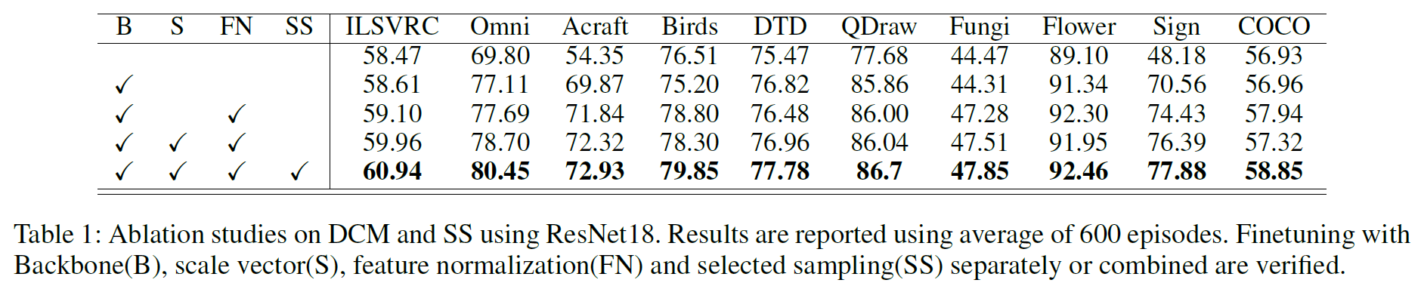
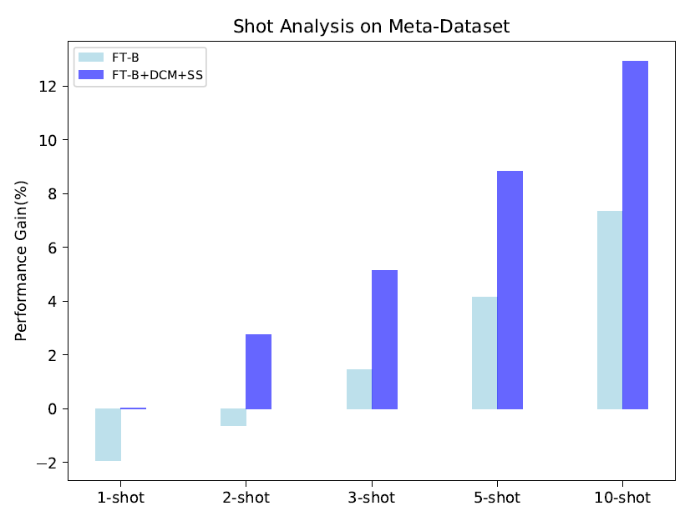
Ablation study

Slide 23
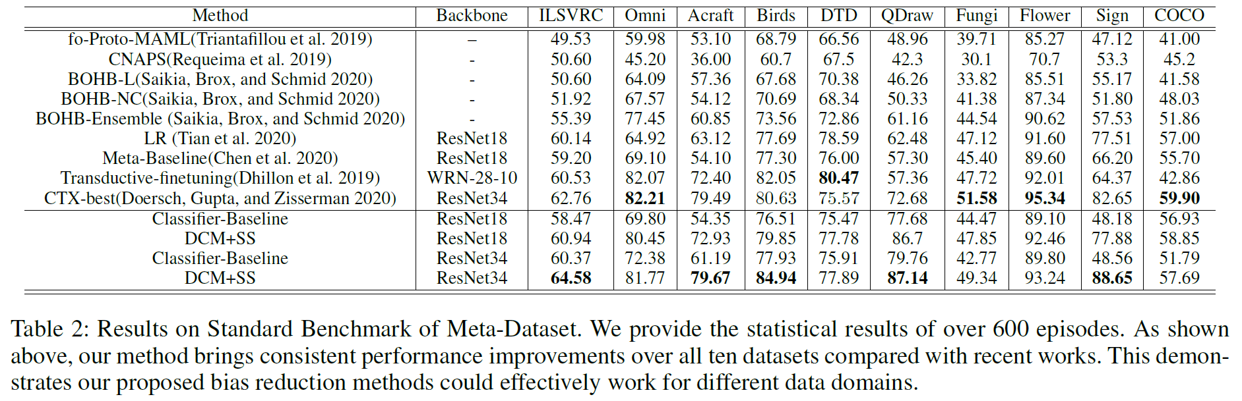
Comparison

Slide 24
Conclusion
Rethink the feature extractor and the feature space
Domain shift from source to target task.
How to sample useful feature in feature space.

